Slide 1

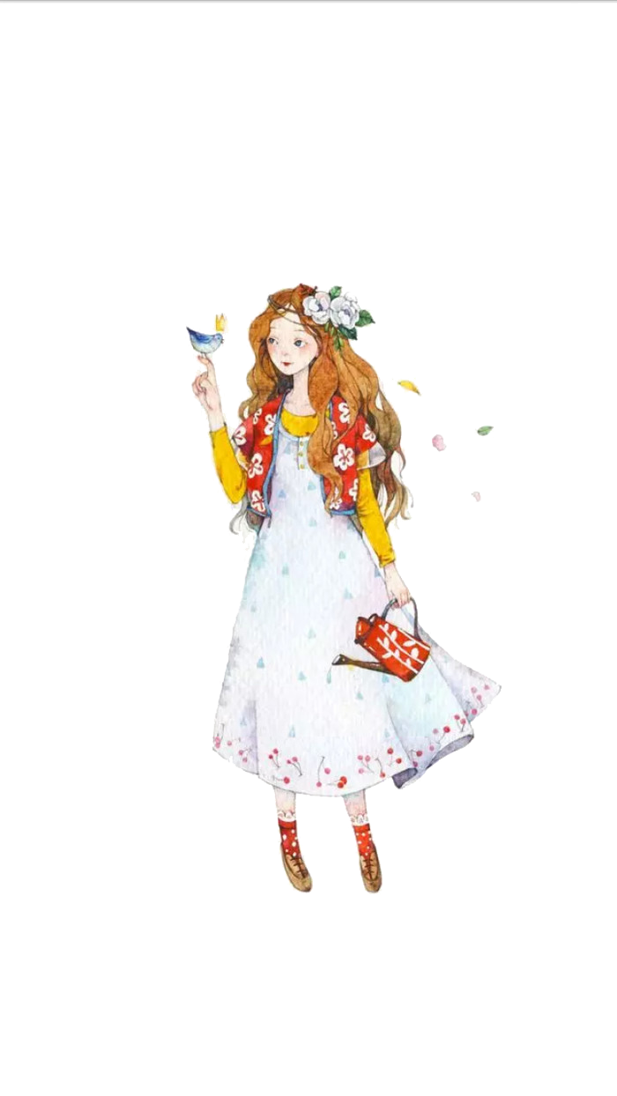
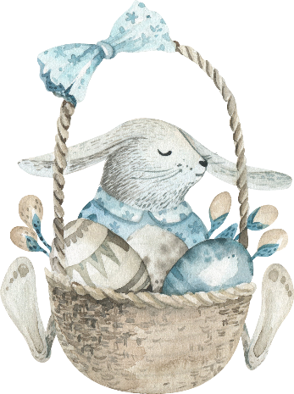

Writing a Notice
By Chen Xiuzhen
BTBU

Slide 2


目录
Sample writing

Slide 3


This notice is for the purpose of recruiting new members for the Students’ Union, and there are certain qualifications for applicants.
To begin with, it is advisable for applicants to possess certain experience and ability to organize activities, which is of great importance for being members of the Students’ Union. In addition, ideal applicants are supposed to communicate with others efficiently. Lastly, we hope you can always try your utmost to accomplish your work. Then, what can you get if you join the Students’ Union.

Slide 4
This job will bring you opportunities to make new friends, arouse your passion for campus activities and of course, help you to cultivate your leadership. Meanwhile, we are convinced that your working experience here will be rewarding for your future job hunting. Accordingly, if you dream to enhance your comprehensive quality, come on and join us.
An interview will be held at 18:00 in the Center of Students’ Activities and everyone is welcome to participate in the interview.
The Students’ Union

Slide 5
Recruiting New Members
Novermber 11th, 2022
The Students’ Union is now recruiting new members. We welcome everyone who is willing to work in a team and would like to make great efforts to help fellow students.
To join the Students’ Union, you will have to be good at communicating effectively with people of various personalities and from different departments of the university. You also have to be capable of organizing a variety of activities. And you will have to be able to accomplish tasks in a timely fashion all the time.

Slide 6
Meanwhile, we have every reason to believe that your working experience here with us will be rewarding for your job hunting in the future after graduation. And you will definitely have great opportunities to make many friends working here. So come on and join us.
An interview will be held at 18:00 Friday, November 25th at the Center of Students’ Activities. Everyone is welcome to the interview.
The Students’ Union

Slide 7


Thank You

